Slide 1
Review of learning 5

Slide 2

Multiple choice (3)
What is the 5th term in a sequence starting with 3 and increasing by 5 each step?
A
B
C
D
25
15
23
28
Notes:
This question connects to the content in the developing number sense activity (Activity 5)
Syllabus focus area:
Multiplicative relations A

Slide 3

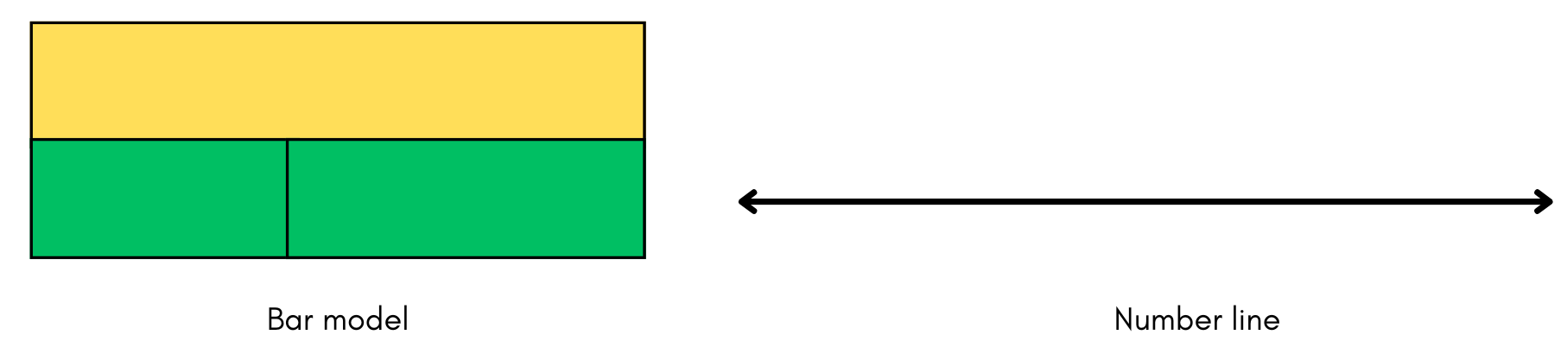
Short response (17)
Mario has 160 coins. He loses 47 coins while running around.
How many coins does he have left?
Represent this problem using a bar model and a number line.
Notes:
Short response questions provide brisk paced questions focussing on review of current and previous content to support spaced and interleaved practice.
Syllabus focus area:
Additive relations A

Slide 4
Short response (18)
Estimate the perimeter of the square.
Communicate your reasoning.
Notes:
Short response questions provide brisk paced questions focussing on review of current and previous content to support spaced and interleaved practice.
Syllabus focus area:
Geometric measure B

Slide 5
Short response (19)
Use the associative property to regroup the factors into multiples of 10 and record the totals.
5 × 70 = becomes 5 × (__ × __) =
4 × 60 = becomes 4 × (__ × __) =
7 × 80 = becomes 7 × (__ × __) =
Notes:
Short response questions provide brisk paced questions focussing on review of current and previous content to support spaced and interleaved practice.
Syllabus focus area:
Multiplicative relations B

Slide 6
Short response (20)
Order the capacities from lowest to highest.
Notes:
Short response questions provide brisk paced questions focussing on review of current and previous content to support spaced and interleaved practice.
Syllabus focus area:
Three-dimensional spatial structure B

Slide 7

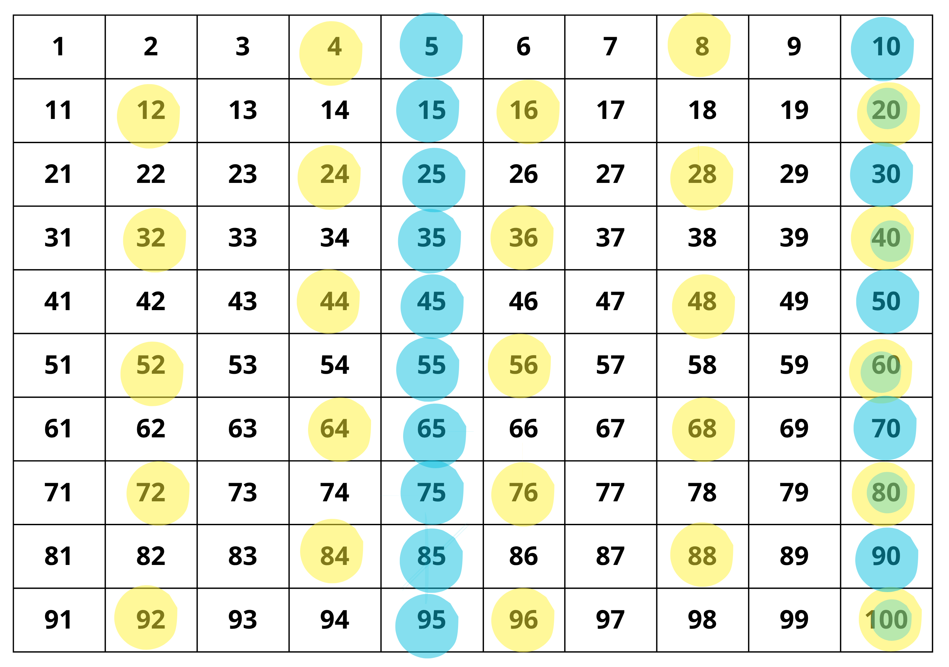
Activity 5 – finding multiples (1)
Notes:
This is a developing number sense activity.
Number sense refers to a deep understanding of numbers, including their magnitude, relationships, and the effects of operations on them. It supports fluency and understanding, estimation, flexible thinking, and efficient problem-solving. Number sense activities 1–4 ‘activate’ prior number knowledge and support the learning of new content in the unit. Number sense activities 5–8 ‘loop’ back and provide opportunity for spaced practice with concepts and procedures covered in previous units.
Syllabus focus area:
Multiplicative relations A
Finding multiples
This resource corresponds to Resource 13 – 100 grid and Resource 14 – blank 100 grid in Stage 2 Year B Unit 35.
Explain that this is a 100 grid with some numbers shaded in yellow, some in blue and some in green. Ask students:
- What do all the colours shaded in yellow have in common?
- What do you notice about all the numbers shaded in blue?
- Why do you think some numbers are shaded in green?
Students turn and talk to discuss their responses. (Yellow numbers are factors of 4, blue numbers are multiples of 5 and green numbers are multiples of both 4 and 5).
(next slide) Provide students with Resource 14 – blank 100 grid. Ask students to shade other multiples patterns on the grid using coloured pencils and describe to a partner.

Slide 8
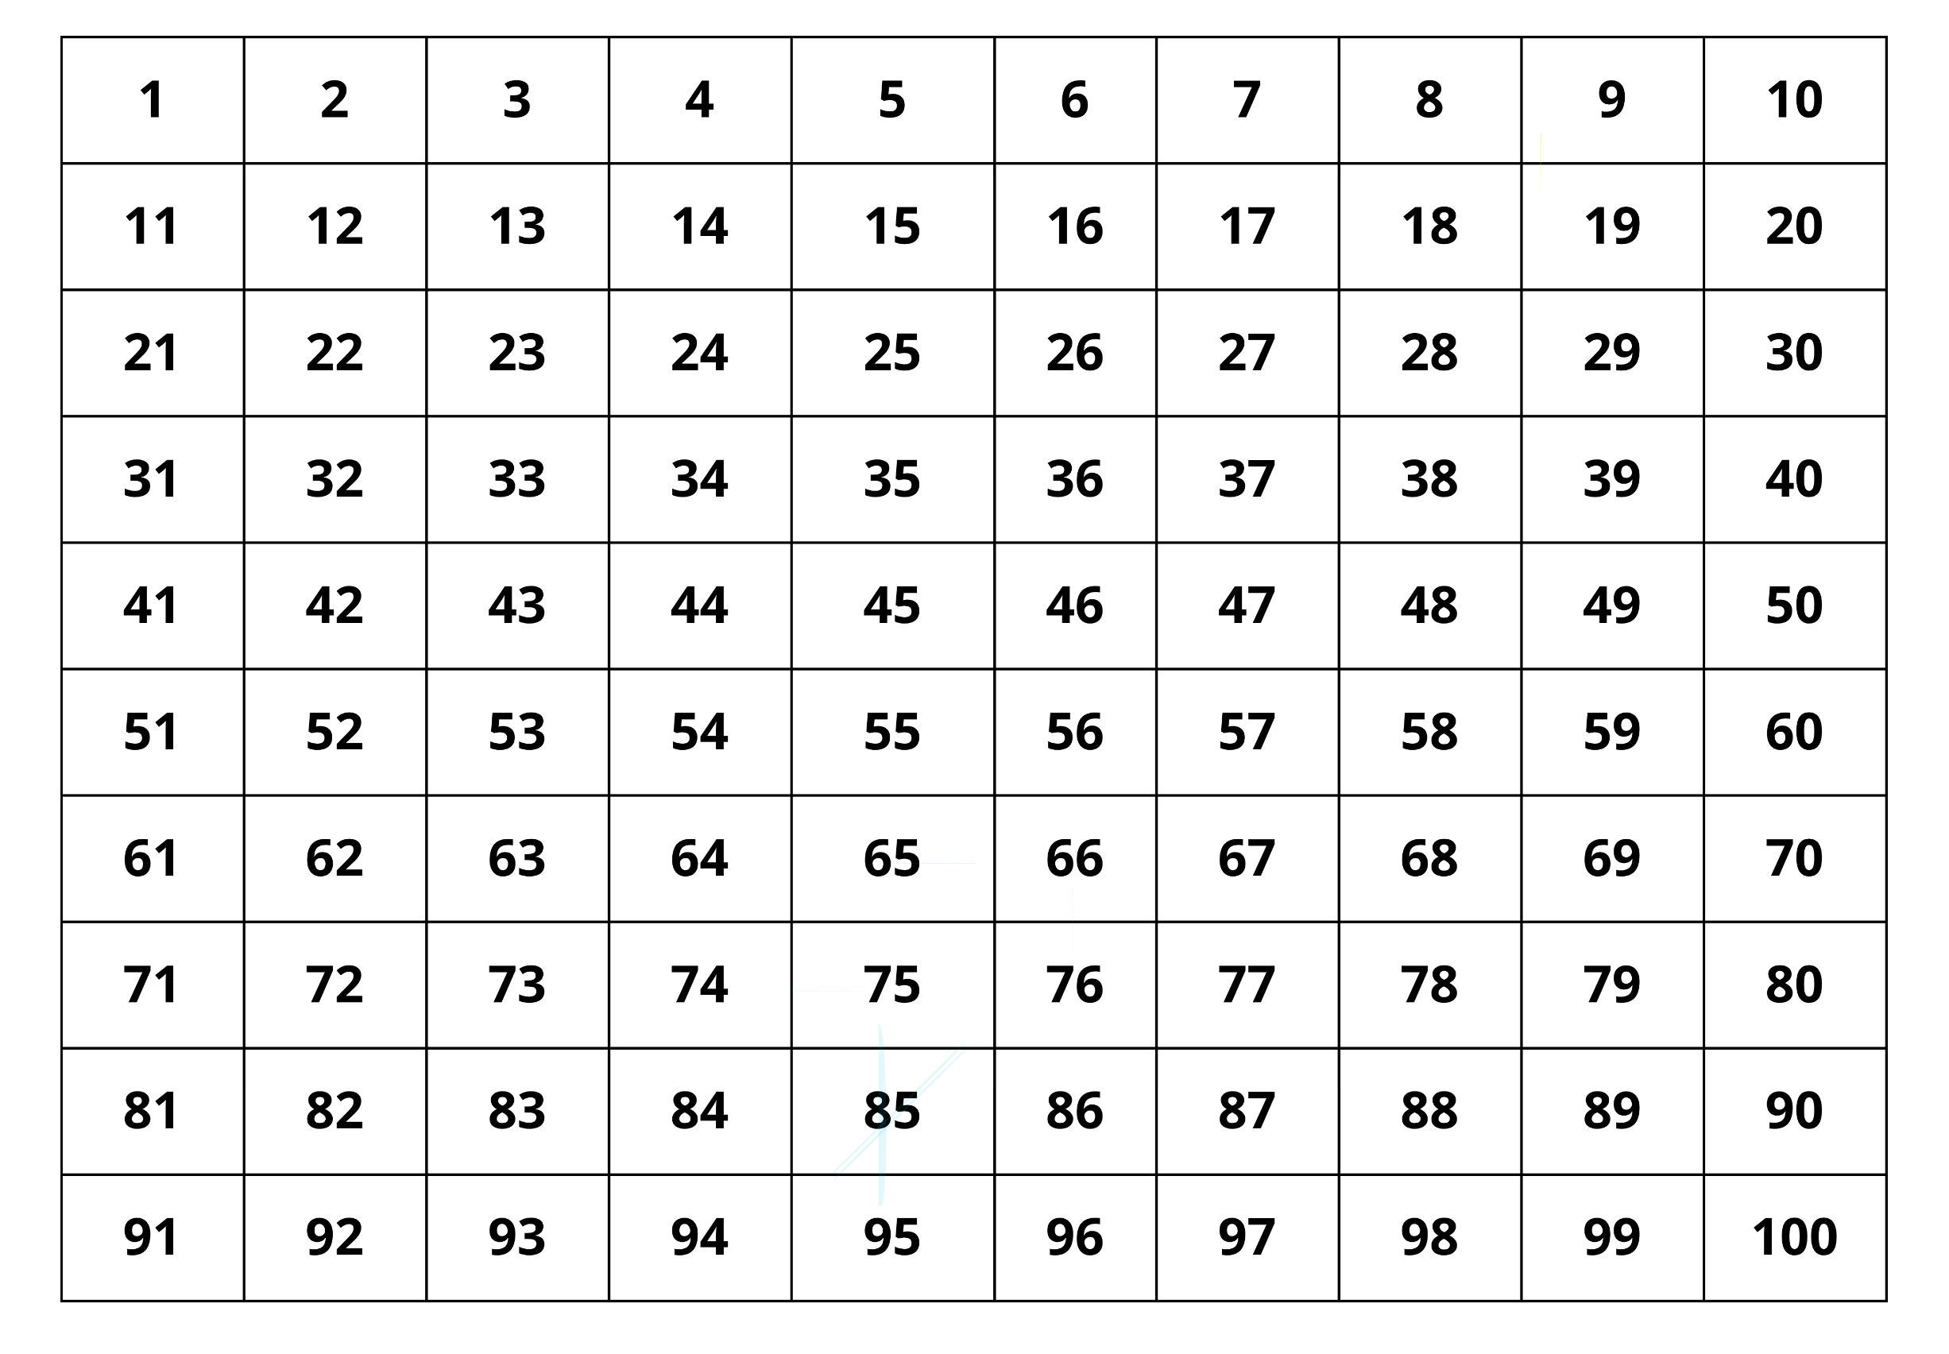
Activity 5 – finding multiples (2)
Notes:
This is a developing number sense activity.
Number sense refers to a deep understanding of numbers, including their magnitude, relationships, and the effects of operations on them. It supports fluency and understanding, estimation, flexible thinking, and efficient problem-solving. Number sense activities 1–4 ‘activate’ prior number knowledge and support the learning of new content in the unit. Number sense activities 5–8 ‘loop’ back and provide opportunity for spaced practice with concepts and procedures covered in previous units.
Syllabus focus area:
Multiplicative relations A
Finding multiples
This resource corresponds to Resource 14 – blank 100 grid in Stage 2 Year B Unit 35.
Provide students with Resource 14 – blank 100 grid. Ask students to shade other multiples patterns on the grid using coloured pencils and describe to a partner.

Slide 9
Review of learning 6

Slide 10

True or false (3)
The coloured tiles are showing multiples of 3.
True | False
Notes:
The question on this slide connects to the content being explored in the developing number sense activity (Activity 6)
Syllabus focus area:
Multiplicative relations A

Slide 11
Short response (21)
Toby chose to use a vertical algorithm to solve 800 – 7.
Is this an efficient strategy?
Communicate your reasoning.
Notes:
Short response questions provide brisk paced questions focussing on review of current and previous content to support spaced and interleaved practice.
Syllabus focus area:
Additive relations B

Slide 12

Short response (22)
My dog Kara is 850 mm tall.
What is Kara’s height in centimetres?
Notes:
Short response questions provide brisk paced questions focussing on review of current and previous content to support spaced and interleaved practice.
Syllabus focus area:
Geometric measure B

Slide 13
Short response (23)
Complete the number sentences:
27 = × 3
27 ÷ 3 =
Notes:
Short response questions provide brisk paced questions focussing on review of current and previous content to support spaced and interleaved practice.
Syllabus focus area:
Multiplicative relations B

Slide 14
Short response (24)
Record these times using am or pm notation:
a) 10 to 9 in the morning
b) 5 o’clock in the evening
Notes:
Short response questions provide brisk paced questions focussing on review of current and previous content to support spaced and interleaved practice.
Syllabus focus area:
Non-spatial measure B

Slide 15
Activity 6 – exploring arrays, multiplication and factors combinations
A lolly manufacturer has decided to design some gift boxes for a new kind of lolly.
Each box will contain 36 lollies placed in lines in a single layer in a geometric shape without gaps.
Each line contains the same number of lollies.
How many different shaped boxes can be designed?
Notes:
This is a developing number sense activity.
Number sense refers to a deep understanding of numbers, including their magnitude, relationships, and the effects of operations on them. It supports fluency and understanding, estimation, flexible thinking, and efficient problem-solving. Number sense activities 1–4 ‘activate’ prior number knowledge and support the learning of new content in the unit. Number sense activities 5–8 ‘loop’ back and provide opportunity for spaced practice with concepts and procedures covered in previous units.
Syllabus focus area:
Multiplicative relations A
Exploring arrays, multiplication and factors combinations
This activity is an adaptation of Sweets in a Box from NRICH by the University of Cambridge.
In pairs, students use 36 counters as lollies to arrange in various-shaped gift boxes and discuss the patterns made.
Students draw designs on grid paper and share ideas with the class.
If time allows, encourage students to try different numbers of lollies such as 24 or 60 in each box.

Slide 16
Review of learning 7

Slide 17
Multiple choice (4)
Double 12 is the same as…
You may choose more than one answer.
A
12 × 12
B
2 × 12
C
2 + 12
D
2 twelves
Notes:
This question connects to the content in the developing number sense activity (Activity 7)
Syllabus focus area:
Multiplicative relations A

Slide 18
Short response (25)
Complete the algorithm by grouping units:
286
+ 437
Notes:
Short response questions provide brisk paced questions focussing on review of current and previous content to support spaced and interleaved practice.
Syllabus focus area:
Additive relations B

Slide 19
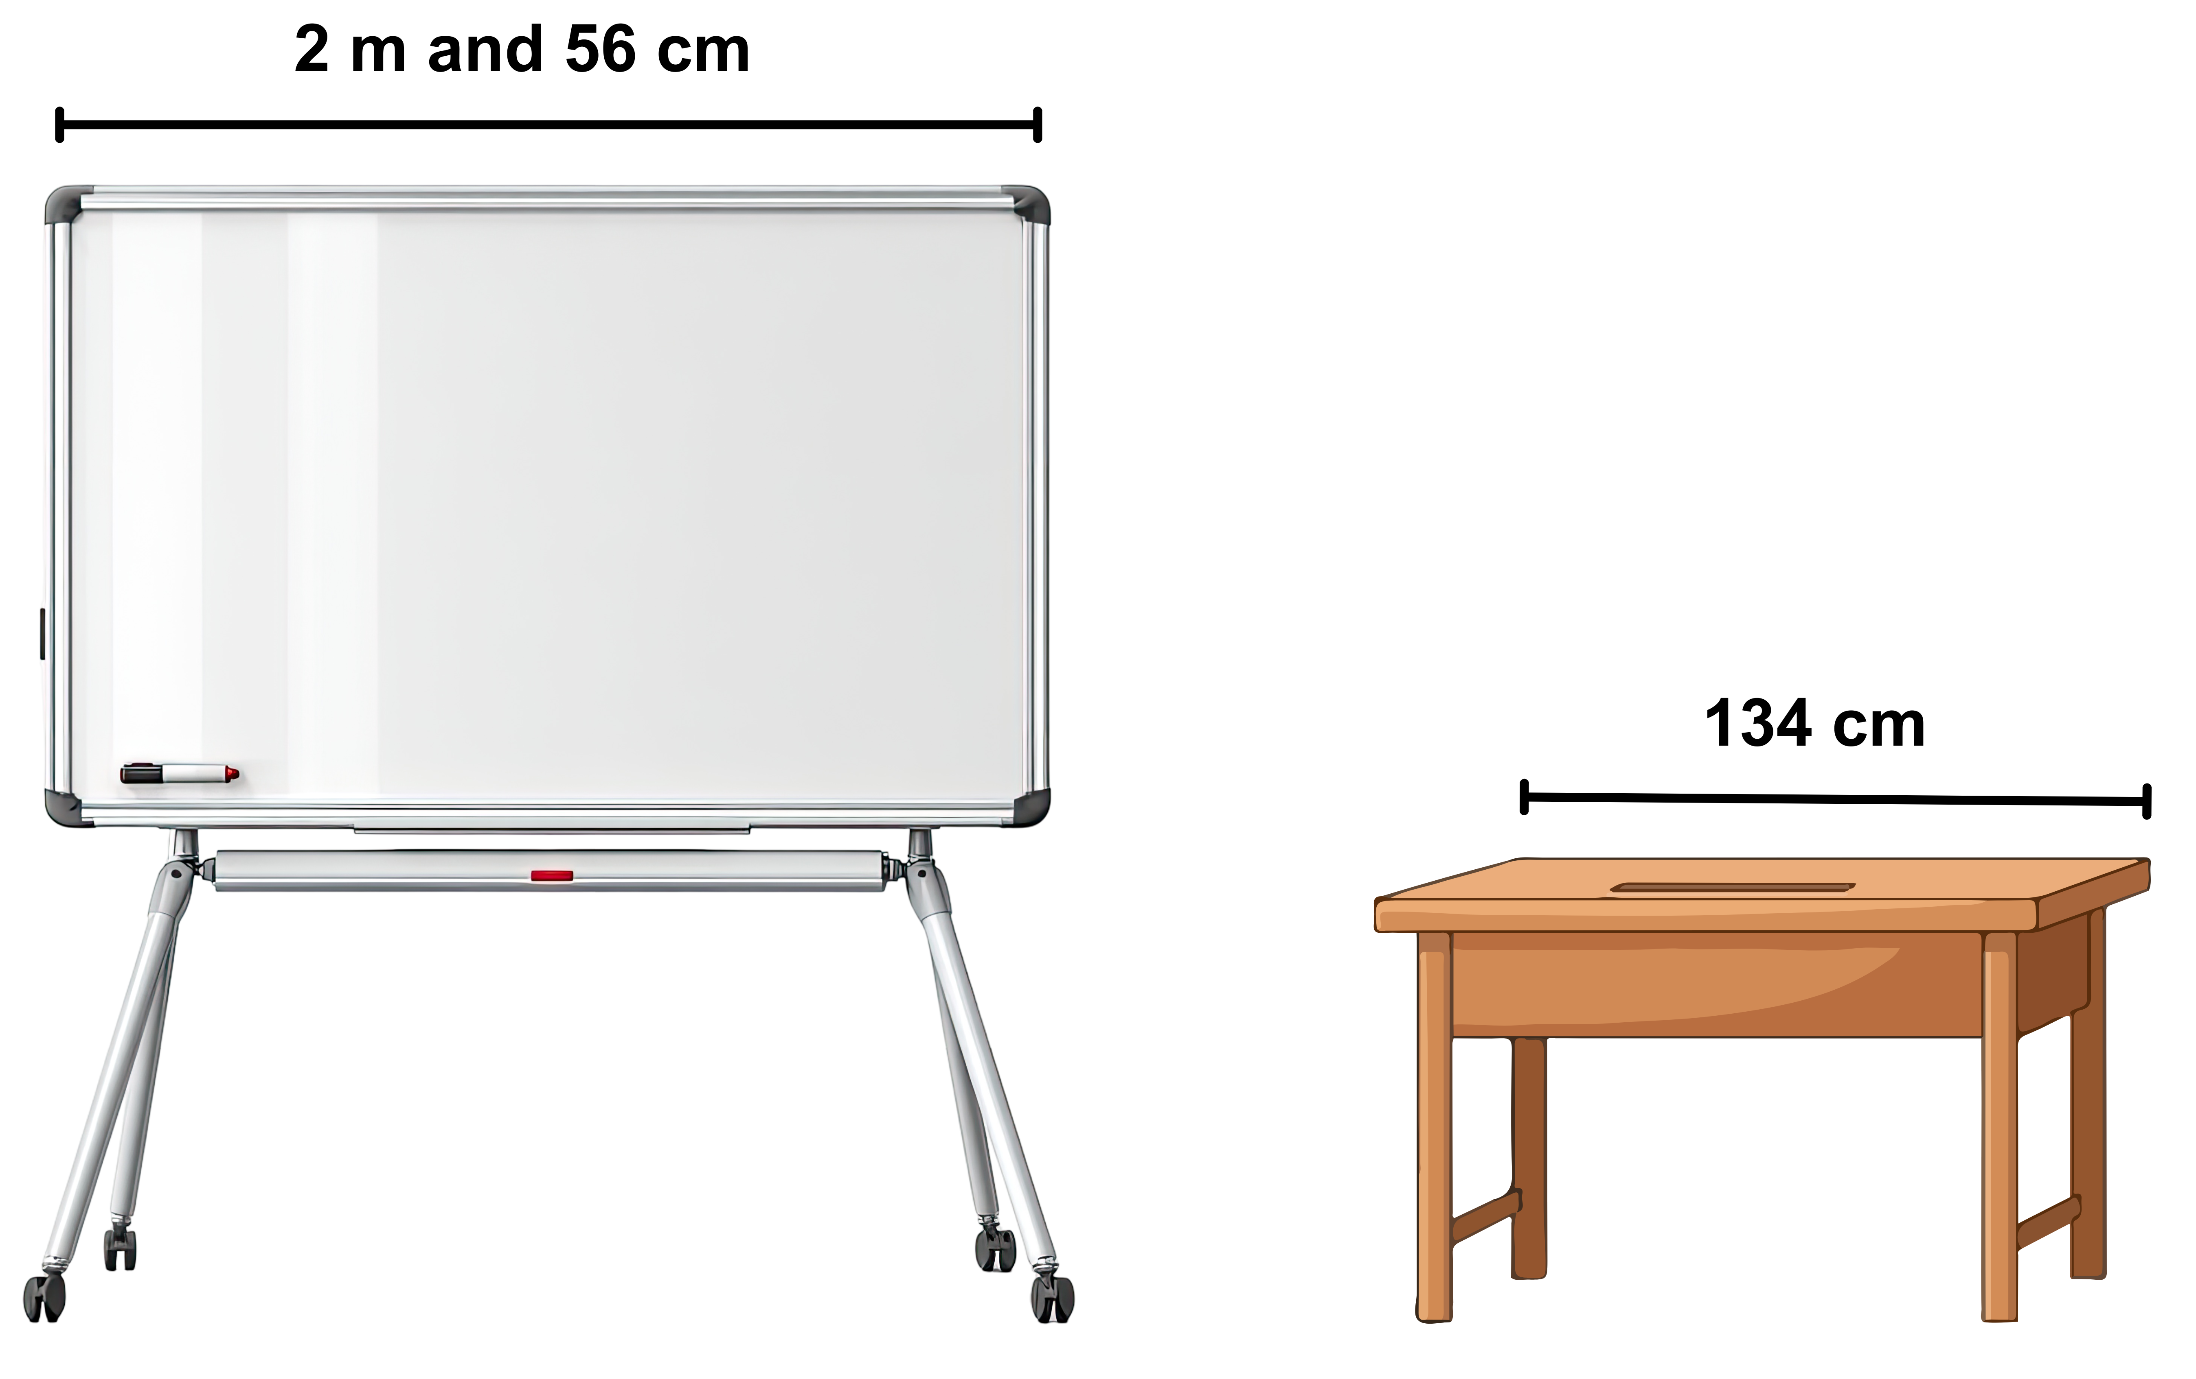
Short response (26)
Convert these measurements to metres.
A
B
Notes:
Short response questions provide brisk paced questions focussing on review of current and previous content to support spaced and interleaved practice.
Syllabus focus area:
Geometric measure B

Slide 20
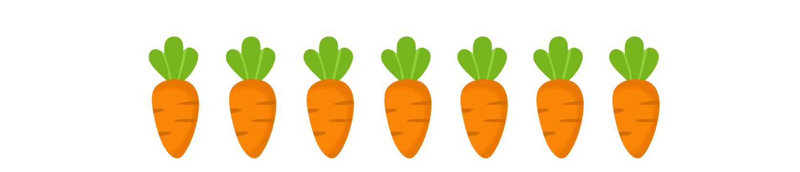
Short response (27)
Farmer Taran plants a garden bed with carrots in
12 rows of 7 seedlings each.
Record the problem as a number sentence and solve it.
Notes:
Short response questions provide brisk paced questions focussing on review of current and previous content to support spaced and interleaved practice.
Syllabus focus area:
Multiplicative relations B

Slide 21
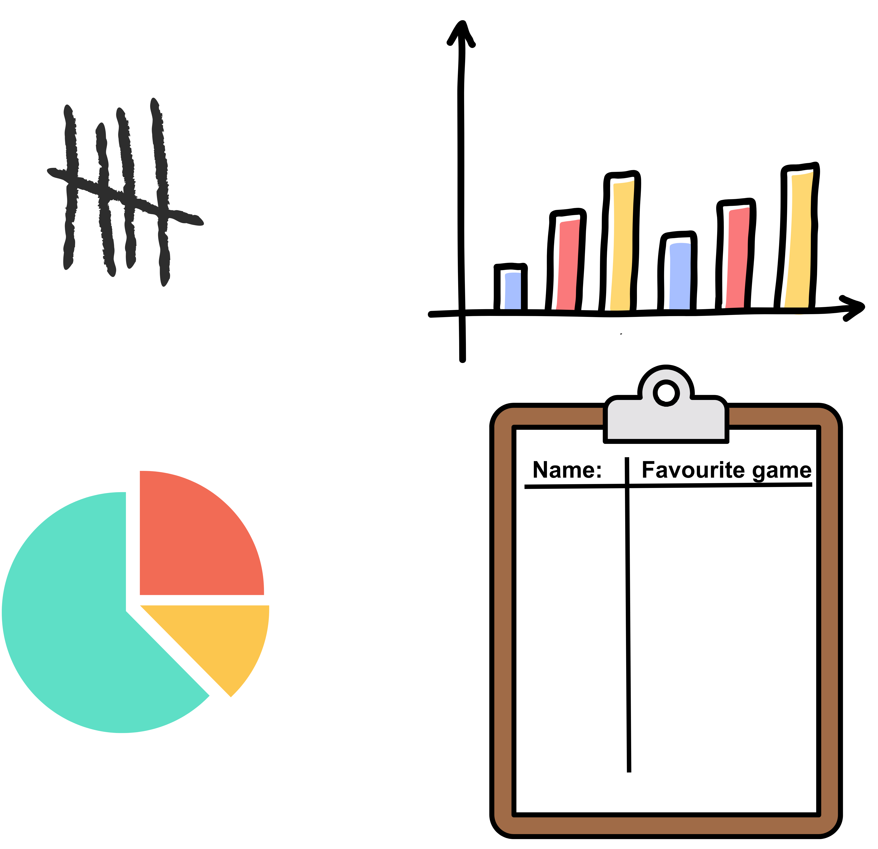
Short response (28)
I want to survey 60 Stage 2 students to find out what their favourite playground games are. What is the most efficient method to collect and record this data?
Communicate your reasoning.
Notes:
Short response questions provide brisk paced questions focussing on review of current and previous content to support spaced and interleaved practice.
Syllabus focus area:
Data B

Slide 22
Activity 7 – doubling and halving
1. Each student takes turns to spin the spinner and multiply the number picked by 2 to model ‘doubling’.
Both students record the solutions in the following ways. For example, if the spinner lands on 6,
record as:
multiplication sentences (6 × 2 = 12, 2 × 6 = 12)
groups (6 twos equal 12)
an array (by colouring 6 rows of 2 on the grid paper or modelling with counters)
Play continues until each partner has two turns.
Repeat the game, this time dividing the number rolled by 2 to show division.
Notes:
This is a developing number sense activity.
Number sense refers to a deep understanding of numbers, including their magnitude, relationships, and the effects of operations on them. It supports fluency and understanding, estimation, flexible thinking, and efficient problem-solving. Number sense activities 1–4 ‘activate’ prior number knowledge and support the learning of new content in the unit. Number sense activities 5–8 ‘loop’ back and provide opportunity for spaced practice with concepts and procedures covered in previous units.
Syllabus focus area:
Multiplicative relations A
Doubling and halving
This resource corresponds to Resource 15 – spinner in Stage 2 Year B Unit 35.
Provide pairs of students with Resource 15 – spinner and grid paper or counters.
Each student takes turns spinning the spinner and multiplying the number landed on by 2 to model ‘doubling’. Both students record the solutions in different ways. For example, if the spinner lands on 6, students record:
- multiplication sentences (6 × 2 = 12, 2 × 6 = 12)
- groups (6 twos equal 12)
- an array (by colouring 6 rows of 2 on the grid paper or modelling with counters).
Play continues until each partner has 2 turns. The activity is then repeated, this time with students dividing the number rolled by 2 to model ‘division’.
Note: students can model the array for division by drawing a line or using an item such as a straw to show how the array is halved when the total is divided by 2. If an odd number is rolled, students may re-roll.

Slide 23
Review of learning 8

Slide 24
True or false (4)
Double 20 = 20 x 2
True | False
Notes:
The question on this slide connects to the content being explored in the developing number sense activity (Activity 8)
Syllabus focus area:
Multiplicative relations A

Slide 25
Short response (29)
I have $10 to spend. I buy a chocolate bar for $2.50, a fruit bowl for $5.25 and
a drink for $1.90.
Do I have enough money to also buy a packet of chips for $2?
Notes:
Short response questions provide brisk paced questions focussing on review of current and previous content to support spaced and interleaved practice.
Syllabus focus area:
Additive relations B

Slide 26

Short response (30)
In a bean bag throwing competition, Tegan completed 3 throws. Convert these measurements to metres:
265 centimetres
280 centimetres
190 centimetres
Notes:
Short response questions provide brisk paced questions focussing on review of current and previous content to support spaced and interleaved practice.
Syllabus focus area:
Geometric measure B

Slide 27

Short response (31)
There are 20 rows with 8 seats per row in a
movie theatre.
Complete the related number sentences:
20 x 8 =
÷ = 20
Notes:
Short response questions provide brisk paced questions focussing on review of current and previous content to support spaced and interleaved practice.
Syllabus focus area:
Multiplicative relations B

Slide 28
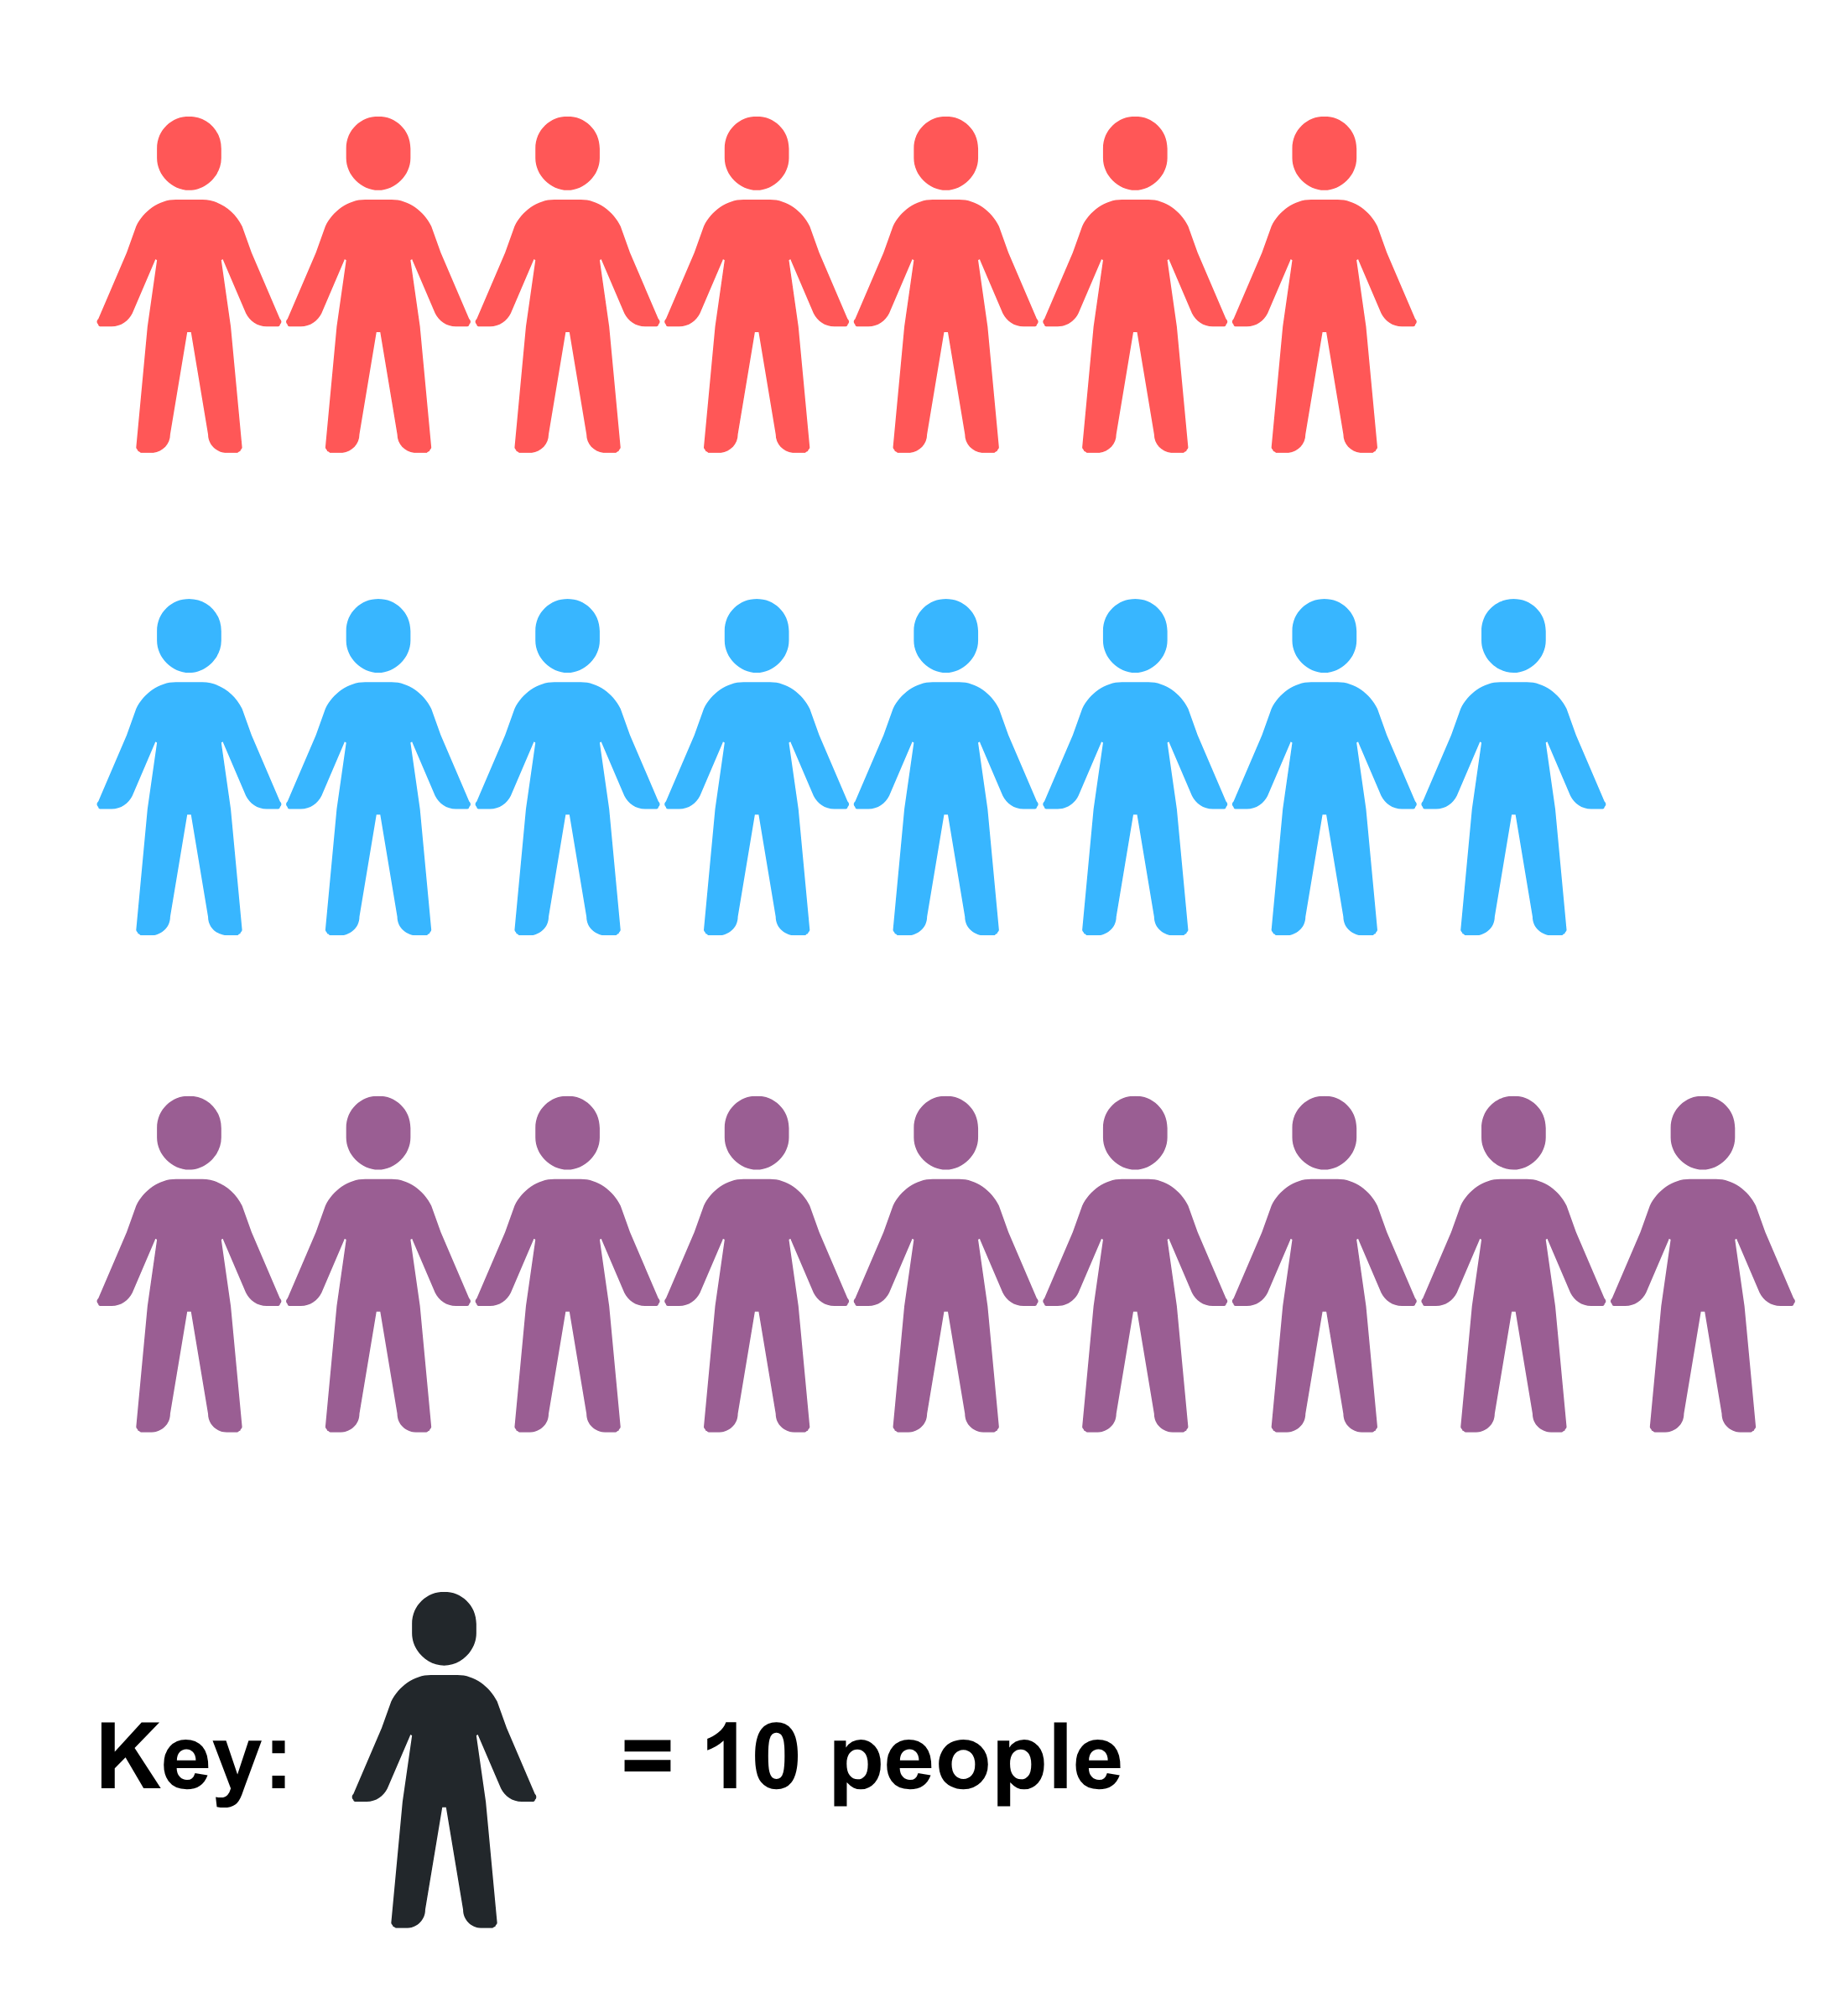
Short response (32)
Sir Taxalot is travelling to 3 small villages to collect money for the king.
The chart shows how many people have paid the tax.
What is the total number of people visited?
Notes:
Short response questions provide brisk paced questions focussing on review of current and previous content to support spaced and interleaved practice.
Syllabus focus area:
Data B

Slide 29
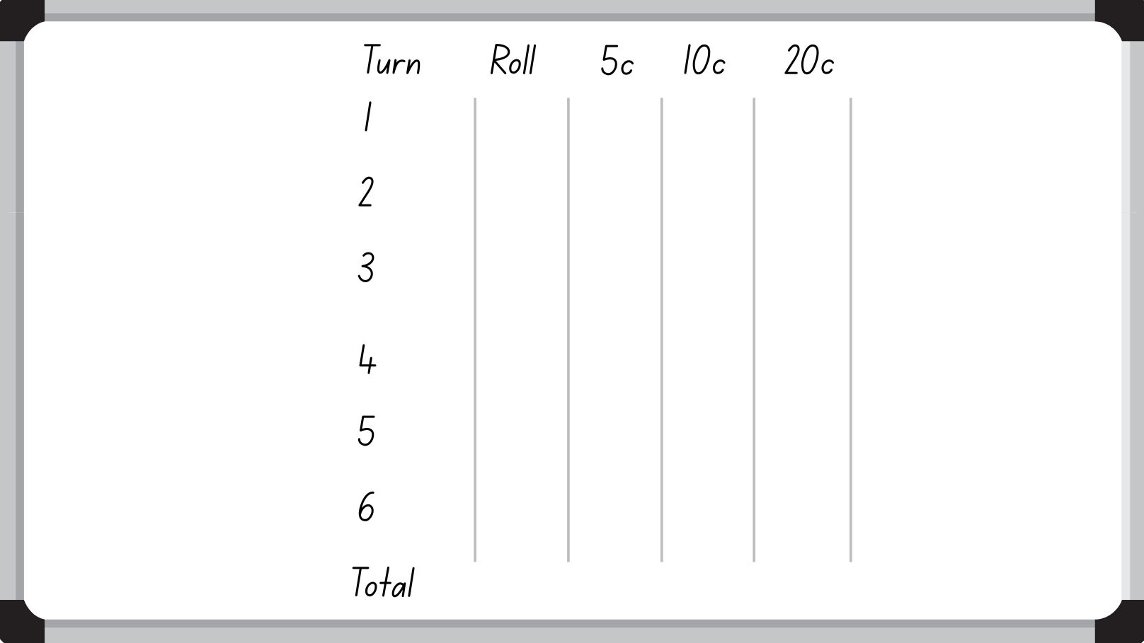
Activity 8 – solving problems involving money
Notes:
This is a developing number sense activity.
Number sense refers to a deep understanding of numbers, including their magnitude, relationships, and the effects of operations on them. It supports fluency and understanding, estimation, flexible thinking, and efficient problem-solving. Number sense activities 1–4 ‘activate’ prior number knowledge and support the learning of new content in the unit. Number sense activities 5–8 ‘loop’ back and provide opportunity for spaced practice with concepts and procedures covered in previous units.
Syllabus focus area:
Multiplicative relations A
Solving problems involving money
This image corresponds to Figure 16 – blank gameboard in Stage 2 Year B Unit 35.
This activity is an adaptation of Penny, Nickel, Dime from Maths for Love by Finkel. The aim of the activity is to use multiplication by 2, 5 and 10 to add coins to the total of $2.
Explain that when multiplying by 5 and by 20, multiplying by 10 is helpful because:
- 5 is 10 ÷ 2 (or 5 is half of 10)
- 20 is 10 × 2 (or 20 is double 10).
Provide an example of how multiplying by 10 can be used to multiply by 5 and 20, such as:
- 6 × 10 = 60, so 6 × 5 = 6 × 10 ÷ 2 = 30
- 6 × 20 = 6 × 10 × 2 = 120.
Link multiplication by 5, 10 and 20 to coins of those denominations.
Provide students with a dice and an individual whiteboard.
Students draw a table with columns labelled ‘5c’, ‘10c’ and ‘20c’ on their whiteboard.
In pairs, students take turns rolling a dice. Player 1 rolls the dice, then multiplies the number by 5c, 10c or 20c and records the total in the respective column. Encourage students to use multiplication facts. Player 2 then has a turn rolling the dice, then calculating and recording the total.
Each player rolls 6 times in total, choosing whether each number goes in the 5c, 10c or 20c column.
The winner is the player who comes closest to $2 without going over (see Figure 17 – completed gameboards in Stage 2 Year B Unit 35).

Slide 30
Double Venn diagram
Object 1
Object 2
Features similar to both objects
Features of object 1
Features of object 2

Slide 31
Frayer
Definition
Facts/Characteristics
Word, term, concept
Examples
Non-examples

Slide 32
Spider map
Idea
Subject

Slide 33
Cline
Concept 1
Concept 2
Word
Word
Word
Word
Word
Word
Word
Word
Word
Word
Word

Slide 34
Compare and contrast

Slide 35
Multiple choice (5)
A
B
C
D

Slide 36
Multiple choice
A
B
C
D
Notes:
This question connects to the content in the developing number sense activity (Activity 3)
Syllabus focus area:
[Focus area A/B]

Slide 37
References (1)
This presentation contains NSW Curriculum and syllabus content. The NSW Curriculum is developed by the NSW Education Standards Authority. This content is prepared by NESA for and on behalf of the Crown in the right of the State of New South Wales. The material is protected by Crown copyright.
Please refer to the NESA Copyright Disclaimer for more information https://educationstandards.nsw.edu.au/wps/portal/nesa/mini-footer/copyright.
NESA holds the only official and up-to-date versions of the NSW Curriculum and syllabus documents. Please visit the NSW Education Standards Authority (NESA) website https://educationstandards.nsw.edu.au/wps/portal/nesa/home and the NSW Curriculum website https://curriculum.nsw.edu.au.
Mathematics K–10 Syllabus © NSW Education Standards Authority (NESA) for and on behalf of the Crown in right of the State of New South Wales, 2022.
National Numeracy Learning Progression © Australian Curriculum, Assessment and Reporting Authority (ACARA) 2010 to present, unless otherwise indicated. This material was downloaded from the Australian Curriculum website (National Numeracy Learning Progression) (accessed 26 March 2026) and was not modified.
Australian Academy of Science (2022) ‘Bar Model Method: Introduction’, Classic sequences for AC V8.4, reSolve website, accessed 26 March 2026.
Finkel D (2021) Penny, Nickel, Dime, Math for Love website, accessed 26 March 2026.
NESA (New South Wales Education Standards Authority) (2022) ‘Reasoning support in Mathematics K–6’, Mathematics K–10 Syllabus: Teaching and learning support, NESA website, accessed 26 March 2026.
State of New South Wales (Department of Education) (2023) Flexible additive strategies – 3-digit numbers, NSW Department of Education website, accessed 26 March 2026.

Slide 38
References (2)
This presentation contains NSW Curriculum and syllabus content. The NSW Curriculum is developed by the NSW Education Standards Authority. This content is prepared by NESA for and on behalf of the Crown in the right of the State of New South Wales. The material is protected by Crown copyright.
Please refer to the NESA Copyright Disclaimer for more information https://educationstandards.nsw.edu.au/wps/portal/nesa/mini-footer/copyright.
NESA holds the only official and up-to-date versions of the NSW Curriculum and syllabus documents. Please visit the NSW Education Standards Authority (NESA) website https://educationstandards.nsw.edu.au/wps/portal/nesa/home and the NSW Curriculum website https://curriculum.nsw.edu.au.
——(2026) ‘Let’s get magical’, Thinking mathematically resources, NSW Department of Education website, accessed 26 March 2026.
University of Cambridge (n.d.) Pocket Money, NRICH website, accessed 26 March 2026.
——(n.d.) Subtraction Surprise, NRICH website, accessed 26 March 2026.
——(n.d.) Sweets in a Box, NRICH website, accessed 26 March 2026.

Slide 39
Copyright
© State of New South Wales (Department of Education), 2025
The copyright material published in this resource is subject to the Copyright Act 1968 (Cth) and is owned by the NSW Department of Education or, where indicated, by a party other than the NSW Department of Education (third-party material).
Copyright material available in this resource and owned by the NSW Department of Education is licensed under a Creative Commons Attribution 4.0 International (CC BY 4.0) license.
This license allows you to share and adapt the material for any purpose, even commercially.
Attribution should be given to © State of New South Wales (Department of Education), 2025.
Material in this resource not available under a Creative Commons license:
the NSW Department of Education logo, other logos and trademark-protected material
Material owned by a third party that has been reproduced with permission. You will need to obtain permission from the third party to reuse its material.
Links to third-party material and websites
Please note that the provided (reading/viewing material/list/links/texts) are a suggestion only and implies no endorsement, by the New South Wales Department of Education, of any author, publisher, or book title. School principals and teachers are best placed to assess the suitability of resources that would complement the curriculum and reflect the needs and interests of their students.
If you use the links provided in this document to access a third party’s website, you acknowledge that the terms of use, including licence terms set out on the third-party’s website apply to the use which may be made of the materials on that third-party website or where permitted by the Copyright Act 1968 (Cth). The department accepts no responsibility for content on third-party websites.

